Slide 1
Design and optimization of IGBT gate drivers
for high insulation voltage up to 30kV
Sokchea AM¹, Pierre LEFRANC¹, David FREY², Rachelle HANNA²
¹University of Grenoble Alpes, G2Elab, Power Electronics Team
²Grenoble Alpes University, G2Elab, Power Electronics Team
Email : sokchea.am@g2elab.grenoble-inp.fr
Tel : +33 4 76 82 71 83

Slide 2
Introduction
Virtual prototyping tool
Optimization results
Experimental results
Conclusion and perspectives
Ecole Thématique 2018,– GRANDS-GAPS : Matériaux Grands Gaps pour l’Electronique de Puissance : Enjeux – Intégration Système – Gate Driver ; 18-22 Juin 2018

Slide 3
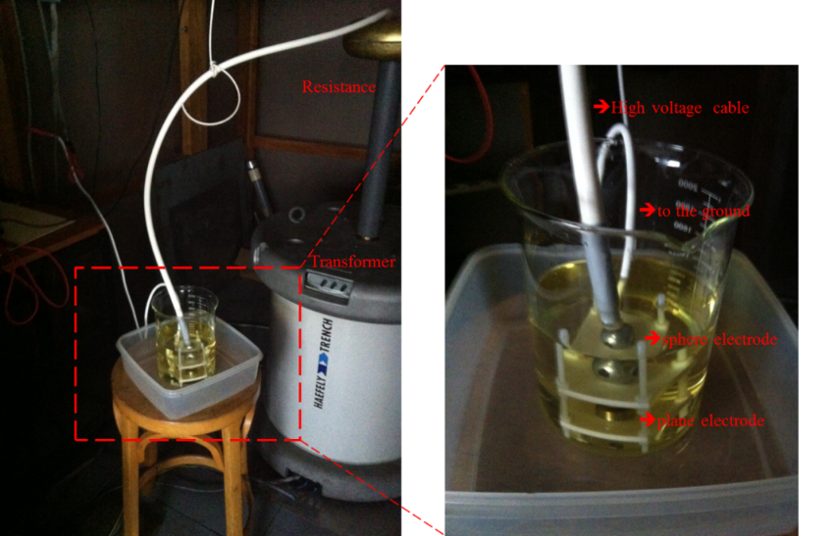
1. Introduction
The objective of the work is to propose and optimize a signal and a power transmission function for an IGBT gate driver with high insulation voltage (up to 30kV).
Firstly, the dielectric material for insulation system is studied.
Secondly, the functions are optimized thanks to virtual prototyping tools.
$${\left(x+a\right)}^{n}=\sum_{k=0}^{n}{\left({n \atop k}\right)x^{k}a^{n−k}}$$
The objective of the work is to propose and optimize a signal and a power transmission function for an IGBT gate driver with high insulation voltage (up to 30kV).
Firstly, the dielectric material for insulation system is studied.
Secondly, the functions are optimized thanks to virtual prototyping tools.
Fig. Validation of the insulator breakdown voltage: Dielectric materials, schematic, experimental instruments
Ecole Thématique 2018,– GRANDS-GAPS : Matériaux Grands Gaps pour l’Electronique de Puissance : Enjeux – Intégration Système – Gate Driver ; 18-22 Juin 2018

