Slide 1
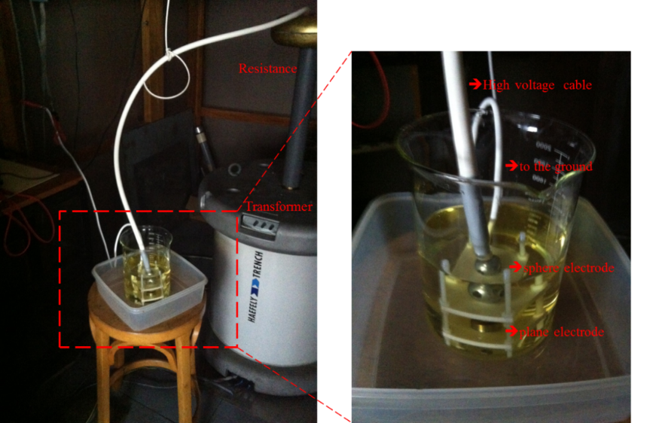





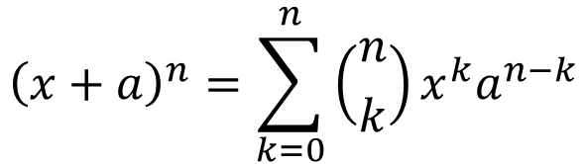
Design and optimization of IGBT gate drivers
for high insulation voltage up to 30kV
Sokchea AM¹, Pierre LEFRANC¹, David FREY², Rachelle HANNA²
¹University of Grenoble Alpes, G2Elab, Power Electronics Team
²Grenoble Alpes University, G2Elab, Power Electronics Team
Email : sokchea.am@g2elab.grenoble-inp.fr
Tel : +33 4 76 82 71 83
Aim of the work
Optimization results
The objective of the work is to propose and optimize a signal and a power transmission function for an IGBT gate driver with high insulation voltage (up to 30kV).
Firstly, the dielectric material for insulation system is studied.
Secondly, the functions are optimized thanks to virtual prototyping tools.
The objective of the work is to propose and optimize a signal and a power transmission function for an IGBT gate driver with high insulation voltage (up to 30kV).
Firstly, the dielectric material for insulation system is studied. Secondly, the functions are optimized thanks to virtual prototyping tools.
Virtual prototyping
Experimental results
Fig. Validation of the insulator breakdown voltage: Dielectric materials, schematic, experimental instruments
Fig. Comparison results for power transmission function
Firstly, the dielectric material for insulation system is studied. Secondly, the functions are optimized thanks to virtual prototyping tools.
The objective of the work is to propose and optimize a signal and a power transmission function for an IGBT gate driver with high insulation voltage (up to 30kV).
Firstly, the dielectric material for insulation system is studied.
Secondly, the functions are optimized thanks to virtual prototyping tools.
$${\left(x+a\right)}^{n}=\sum_{k=0}^{n}{\left({n \atop k}\right)x^{k}a^{n−k}}$$
Conclusion: the proposed circuits for signal and power transmission functions for IGBT gate drivers for high insulation capabilities are studied and optimized (0.5mm ≈ 20kV).
  Future works: Proposed gate driver for one Sub-module of MMC for Medium Voltage applications with thickness of 1mm (up to 30kV).

